Slide 1



Linear Algebra For Machine Learning

Slide 2
Agenda
01
What is a Matrix?
02
5 | 2 | 9
4 | 6 | 7
1 | 3 | 8
Matrix Operations
Number of Rows
03
Eigen Values
04
Eigen Vectors

Slide 3
What is a Matrix?

Slide 4
What is a Matrix?
A Matrix is a combination of arrays, numbers or expressions that are represented in a rectangular format in the form of rows and columns.
Number of Columns
5 | 2 | 9
4 | 6 | 7
1 | 3 | 8
Number of Rows

Slide 5
What is a Matrix?
Number of Columns(n)
The rows and columns of a matrix are associated with the dimensions of a matrix and immensely help while working with linear expressions. The matrix with m rows and n columns will have the m x n dimensions.
5 | 2 | 9
4 | 6 | 7
1 | 3 | 8
Number of Rows(m)

Slide 6
What is a Matrix?
Number of Columns(n)
Let us go through some of the Matrix operations like addition, subtraction, multiplication, transpose, inverse of a matrix, etc.
5 | 2 | 9
4 | 6 | 7
1 | 3 | 8
Number of Rows(m)

Slide 7
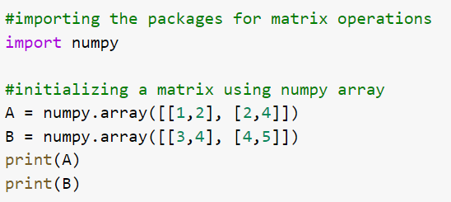
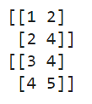
Hands on - Python
Output
In Python, we use the list of lists in a numpy array to declare a list. As seen in the example we have declared A and B matrices with dimensions 2x2.

Slide 8
Matrix Operations

Slide 9
Addition
5 | 2 | 2
4 | 6 | 7
1 | 3 | 2
4 | 5 | 4
2 | 3 | 2
1 | 2 | 4
9 | 7 | 6
6 | 9 | 9
2 | 5 | 6
In the addition operation, the corresponding values of the elements are added to the resultant matrix like shown in the example.

Slide 10
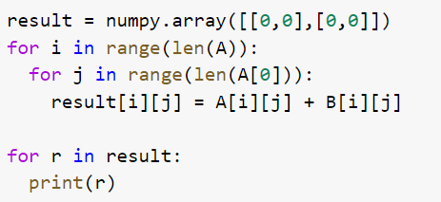
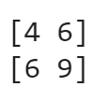
Hands on - Python
Output
In this example, we have used the matrices A and B declared in the previous example and with the help of for loops, performed an addition operation on matrices.

Slide 11
Addition
5 | 2 | 2
4 | 6 | 7
1 | 3 | 2
4 | 5 | 4
2 | 3 | 2
1 | 2 | 4
9 | 7 | 6
6 | 9 | 9
2 | 5 | 6
In the addition operation, it is mandatory that the dimensions of the matrices are equivalent to each other.

Slide 12
Subtraction
5 | 2 | 2
4 | 6 | 7
1 | 3 | 2
4 | 5 | 4
2 | 3 | 2
1 | 2 | 4
1 | -3 | -2
2 | 3 | 5
0 | 1 | -2
Similar to the addition operation, in subtraction we will subtract the corresponding element in both the matrices to get the resultant matrix.

Slide 13
Subtraction
5 | 2 | 2
4 | 6 | 7
1 | 3 | 2
4 | 5 | 4
2 | 3 | 2
1 | 2 | 4
1 | -3 | -2
2 | 3 | 5
0 | 1 | -2
In the subtraction operation, it is mandatory for the matrices to be of equivalent dimensions as well.

Slide 14
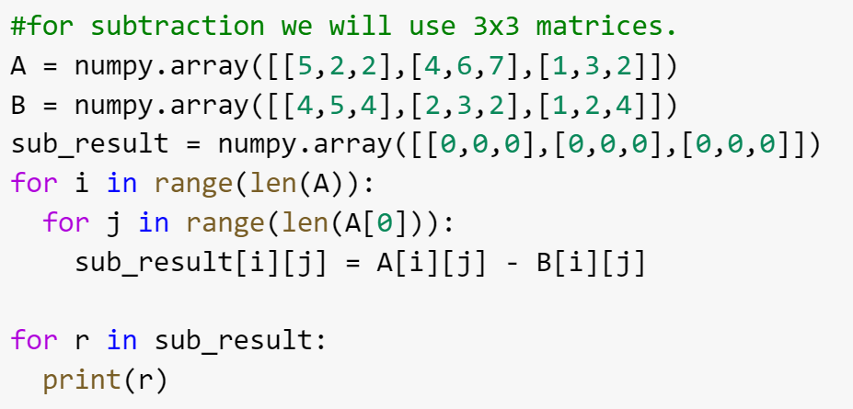
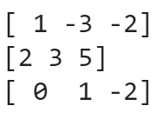
Hands on - Python
Output
In this example, we have used the matrices A and B with dimensions 3x3 and performed the subtraction using the for loops and numpy array.

Slide 15
Multiplication
5 | 2 | 9
4 | 6 | 7
1 | 3 | 8
10 | 4 | 18
8 | 12 | 14
2 | 6 | 16
2
Multiplying a matrix with a scalar will yield the resultant matrix that will have each element multiplied with the scalar.

Slide 16
Multiplication
Scalar multiplication will not only have the same dimensions, but will show the properties like distributivity, associativity, additive inverse, etc.
5 | 2 | 9
4 | 6 | 7
1 | 3 | 8
2

Slide 17
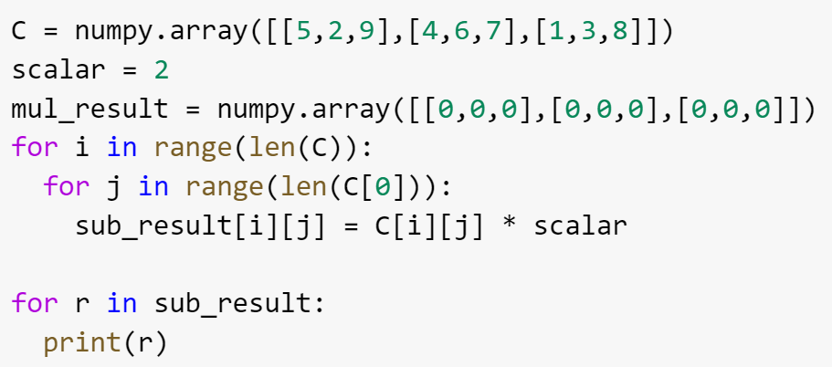
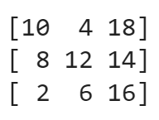
Hands on - Python
Output
In this example, we have multiplied a 3x3 matrix with a scalar.

Slide 18
Vector Multiplication
While multiplying a matrix with a column vector, we must figure out the dimensions of the resultant matrix. For this, the rows of the first matrix and the columns of the second matrix will be the dimensions of the resultant matrix.
5 | 2 | 9
4 | 6 | 7
1 | 3 | 8
1
2
4

Slide 19
Vector Multiplication
The dimensions of the first matrix is 3x3 and that of the second matrix is 3x1. Therefore, the dimensions of the resultant matrix will be 3x1.
5 | 2 | 9
4 | 6 | 7
1 | 3 | 8
1
2
4

Slide 20
Vector Multiplication
5 | 2 | 9
4 | 6 | 7
1 | 3 | 8
1
2
4
X
Y
Z
For finding the elements of the resultant matrix, we multiply the rows of the first matrix to the column of the second matrix.

Slide 21
Vector Multiplication
5 | 2 | 9
4 | 6 | 7
1 | 3 | 8
1
2
4
45
44
39
X = (5x1) + (2x2) + (9x4) = 5+4+36 = 45
Y = (4x1) + (6x2) + (7x4) = 4+12+28 = 44
Z = (1x1) + (3x2) + (8x4) = 1+6+32 = 39

Slide 22
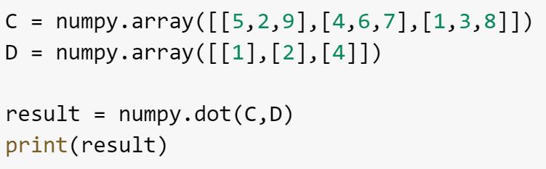
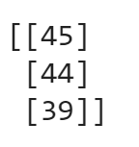
Hands on - Python
Output
In this example, we have used the numpy.dot() method to multiply the two matrices.

Slide 23
Matrix Multiplication
Similar to the vector multiplication, we will determine the dimension of the resultant matrix from these two matrices.
5 | 2 | 9
4 | 6 | 7
1 | 3 | 8
1 | 2
2 | 1
1 | 2

Slide 24
Matrix Multiplication
The dimension of the first matrix is 3x3 and that of the second matrix is 3x2. Therefore the dimension of the resultant matrix will be 3x2.
5 | 2 | 9
4 | 6 | 7
1 | 3 | 8
1 | 2
2 | 1
1 | 2

Slide 25
Matrix Multiplication
5 | 2 | 9
4 | 6 | 7
1 | 3 | 8
1 | 2
2 | 1
1 | 2
x1 | x2
y1 | y2
z1 | z2

Slide 26
Matrix Multiplication
X1 = (5x1) + (2x2) + (9x1) = 5+4+9 = 18
X2 = (5x2) + (2x1) + (9x2) = 10+2+18 = 30
5 | 2 | 9
4 | 6 | 7
1 | 3 | 8
1 | 2
2 | 1
1 | 2
X1 = (4x1) + (6x2) + (7x1) = 4+12+7 = 23
X2 = (4x2) + (6x1) + (7x2) = 8+6+14 = 28
X1 = (1x1) + (3x2) + (8x1) = 1+6+8 = 15
X2 = (1x2) + (3x1) + (8x2) = 2+3+16 = 21

Slide 27
Matrix Multiplication
5 | 2 | 9
4 | 6 | 7
1 | 3 | 8
1 | 2
2 | 1
1 | 2
18 | 30
23 | 28
15 | 21
There is a limitation with matrix multiplication that states that the columns of the first matrix should always be equal to the rows of the second matrix. For example – if the dimensions of the above matrices were 3x3 and 2x2, the multiplication would not have been possible.

Slide 28
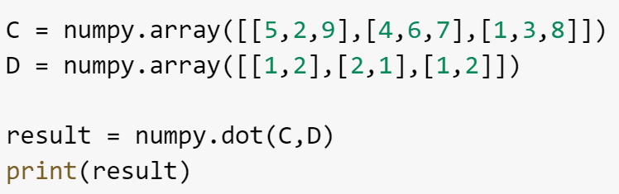
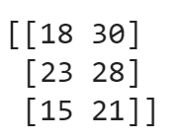
Hands on - Python
Output
In this example, we have used the numpy.dot() method to multiply the two matrices.

Slide 29
Matrix Multiplication
The dimension of the first matrix is 3x3 and that of the vector is 3x3. Therefore, the dimension of the resultant matrix will be 3x3.
5 | 2 | 9
4 | 6 | 7
1 | 3 | 8
5 | 2 | 9
4 | 6 | 7
1 | 3 | 8

Slide 30
Matrix Multiplication
The approach would be same here, we will multiply the rows of the first matrix to the column of the second matrix.
5 | 2 | 9
4 | 6 | 7
1 | 3 | 8
1 | 2 | 1
3 | 1 | 2
4 | 2 | 1

Slide 31
Matrix Multiplication
5 | 2 | 9
4 | 6 | 7
1 | 3 | 8
1 | 2 | 1
3 | 1 | 2
4 | 2 | 1
47 | 30
X1 = (5x1) + (2x3) + (9x4) = 5+6+36 = 47
X2 = (5x2) + (2x1) + (9x2) = 10+2+18 = 30

Slide 32
Matrix Multiplication
5 | 2 | 9
4 | 6 | 7
1 | 3 | 8
1 | 2 | 1
3 | 1 | 2
4 | 2 | 1
47 | 30 | ?
? | ? | ?
? | ? | ?
Similarly, you can find the rest of the elements of the resultant matrix.

Slide 33
Matrix Multiplication
5 | 2 | 9
4 | 6 | 7
1 | 3 | 8
1 | 2 | 1
3 | 1 | 2
4 | 2 | 1
47 | 30 | 18
50 | 28 | 23
42 | 21 | 15

Slide 34
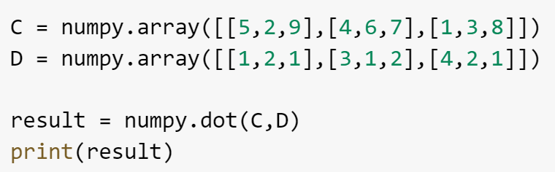
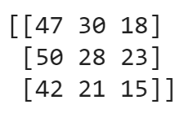
Hands on - Python
Output
In this example, we have used the numpy.dot() method to multiply the two matrices.

Slide 35
Cross Product
3
2
8
2
9
7
i | j | k
3 | 2 | 8
2 | 9 | 7
i
2 | 8
9 | 7
3 | 8
2 | 7
k
3 | 2
2 | 9
j

Slide 36
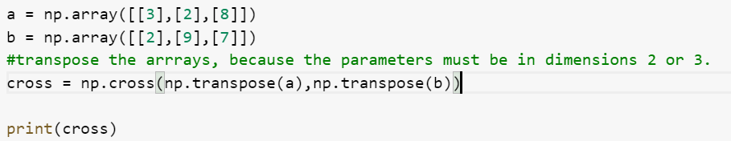

Hands on - Python
Output
In this example, we have used the numpy.cross() method to find the cross product of the two matrices.

Slide 37
Transpose
T
1 | 2
1 | 1
0 | 2
1 | 1 | 0
2 | 1 | 2
In the transpose of a matrix, the columns and rows are interchanged like shown in the example.

Slide 38
Properties of Transpose of a Matrix
Transpose of a Transposed matrix is the original matrix
(A’)’ = A
Additive property of transpose of a matrix
(A+B)’ = A’ + B’
Multiplication by a Constant
K x A’ = KA’, Where K is a constant
Multiplication property of the transpose:
(AB)’ = B’A’

Slide 39
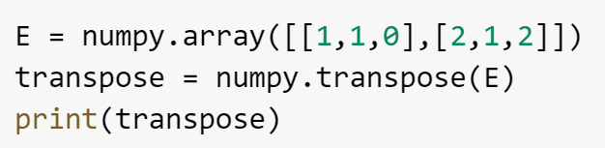
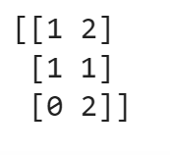
Hands on - Python
Output
In this example, we have used the numpy.transpose() method to obtain the transpose of the matrix E.

Slide 40
Inverse
-1
5 | 2 | 9
4 | 6 | 7
1 | 3 | 8
To understand the inverse of a matrix, there are several concepts that you must be familiar with like determinant of a matrix, adjoint of a matrix, etc.

Slide 41
Inverse – Determinant of a Matrix
5 | 2 | 9
4 | 6 | 7
1 | 3 | 8
We can follow the laplacian expansion method to find the determinant of the matrix. It helps us in finding the inverse of the matrix.

Slide 42
Inverse – Determinant of a 2x2 Matrix
a | b
c | d
|Matrix| = a x d – b x c
1 | 4
6 | 9
|Matrix| = 1 x 9 – 4 x 6 = 9 – 24 = -15

Slide 43
Inverse – Determinant of a 3x3 Matrix
a | b | c
d | e | f
g | h | i
|Matrix| = a(e x i – f x h) – b(d x i – f x g) + c(d x h – e x g)
2 | 2 | -3
1 | 2 | 2
1 | 1 | 2
|Matrix| = 2(2 x 2 – 2 x 1) – 2(1 x 2 – 2 x 1) – 3(1 x 1 – 2 x 1)
= 2(2) – 2(0) – 3(-1)
= 4 – 0 – (-3)
= 4 + 3 = 7

Slide 44
Inverse – Adjoint of a Matrix
5 | 2 | 9
4 | 6 | 7
1 | 3 | 8
To find the adjoint of a given matrix, we have to find the transpose of the cofactors of the elements in the given matrix. It is also known as adjugate of a matrix.

Slide 45
Inverse – Adjoint of a Matrix
5 | 2 | 9
4 | 6 | 7
1 | 3 | 8
m11 | m12 | m13
m21 | m22 | m23
m31 | m32 | m33
The minor (m11, m12,… mij) are the determinants of the square matrix that is formed after eliminating the i^{th} row and j^{th} column of the matrix. We use the minors to calculate the cofactors of the given matrix.

Slide 46
Inverse – Adjoint of a Matrix
5 | 2 | 9
4 | 6 | 7
1 | 3 | 8
m11 | m12 | m13
m21 | m22 | m23
m31 | m32 | m33
Formulae to find the cofactors = Cij = (-1)^{i+j}|mij|
We will use the above formulae to calculate the cofactors of the given matrix.

Slide 47
Inverse – Adjoint of a Matrix
m11 = 48 – 21 = 27
m22 = 40 – 9 = 31
m12 = 32 – 7 = 25
m23 = 15 -2 = 13
m13 = 12 – 6 = 6
m31 = 14 – 54 = -40
m21 = 16 – 27 = -11
m32 = 35 – 36 = -1
m33 = 30 – 8 = 22

Slide 48
Inverse – Adjoint of a Matrix
T
27 | -25 | 6
11 | 31 | -13
-40 | 1 | 22
27 | 11 | -40
-25 | 31 | 1
6 | -13 | 22
Let’s take a look at the formulae to find the inverse of the matrix.

Slide 49
Inverse – Formulae
-1
The formulae to calculate the inverse of a matrix is as follows:
A⁻¹ = 1/|A|. Adj A
2 | 1
4 | 3

Slide 50
Inverse – Formulae
-1
Now, to calculate the inverse, we will find the determinant and adjoint of the given matrix.
2 | 1
4 | 3

Slide 51
Inverse – Formulae
Adjoint of the given matrix is
3 | -1
-4 | 2
Determinant of the given matrix is
=> 2x3 – 4x1 = 2

Slide 52
Inverse – Formulae
-1
2 | 1
4 | 3
3/2 | -1/2
-2 | 1
To verify the result we can use the inverse property that states that:
AA⁻¹ = I , where I is the identity matrix.

Slide 53
Inverse – Formulae
2 | 1
4 | 3
3/2 | -1/2
-2 | 1
1 | 0
0 | 1
Since we are getting an identity matrix when we did AA⁻¹, we have calculated the inverse of the matrix successfully. We can follow the same formulae for the 3x3 matrix as well – where the adjoint and the determinant will determine the inverse of the given matrix.

Slide 54
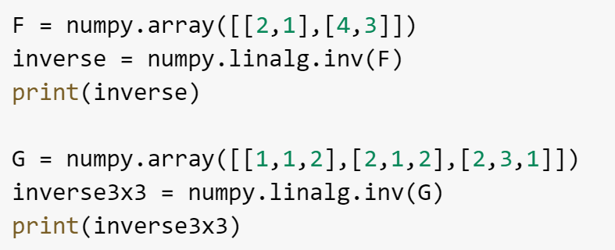
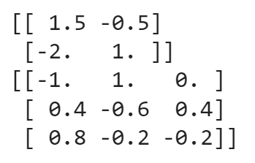
Hands on - Python
Output
In this example, we have used the numpy.linalg.inv() method to calculate the inverse of a 2x2 and a 3x3 matrices F and G respectively.

Slide 55
Rank of a Matrix
The number of linearly independent columns in a matrix is known as the rank of the matrix. There are several ways we can use to calculate the rank of the matrix. One such method is to reduce the matrix to its row-echelon form.
1 | 0 | 0
0 | 1 | 0
0 | 0 | 1
ρ(A)

Slide 56
Rank of a Matrix
Things to Remember:
If the matrix A is of the order mxm, and if the determinant of |A| is not equal to zero, then the rank of the matrix will be m.
If the determinant is equal to zero, the rank will be less than m.
1 | 0 | 0
0 | 1 | 0
0 | 0 | 1

Slide 57
Rank of a Matrix
Row Echelon Form
The pivots go from top-left to bottom right. Pivots are the first non-zero element in the row.
There must be a zero below the pivots in the row echelon form.
The rows will all zero elements must be at the end of the matrix.
1 | 0 | 0
0 | 1 | 0
0 | 0 | 1

Slide 58
Rank of a Matrix
1 | 2 | 2
0 | 1 | 4
2 | 4 | 4
1 | 2 | 2
0 | 1 | 4
0 | 0 | 0
We can use the gaussian elimination method where we interchange, multiply and add the rows to reach the row echelon form. Here, we have used the following operation to get the row echolen form.
R3 = R3 – 2R1
Since, the non-zero rows are 2, hence the rank of the matrix is 2.

Slide 59
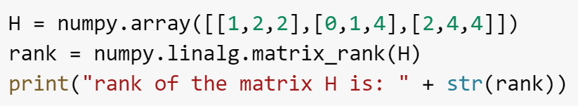

Hands on - Python
Output
In this example, we have used the numpy.linalg.matrix_rank() method to calculate the rank of the given matrix.

Slide 60
Matrix Factorization
Matrix factorization, also known as decomposition is a process where a matrix is reduced to various components/factors that can be used for complex operations. There are various ways to decompose a matrix, let’s take a look at a few ways to perform matrix Factorization.
5 | 2 | 9
4 | 6 | 7
1 | 3 | 8

Slide 61
Matrix Decomposition
5 | 2 | 9
0 | 6 | 7
0 | 0 | 8
5 | 0 | 0
4 | 6 | 0
1 | 3 | 8
Upper Triangle Matrix
In the upper triangle matrix all the elements below the diagonal are zero.
Lower Triangle Matrix
In the lower triangle matrix, all the elements above the diagonal are zero.

Slide 62
LU Decomposition
LU decomposition is the method in which the matrix A is decomposed in the following manner:
A = L.U
Where L is the lower triangle matrix and U is an Upper triangle matrix.
a11 | a12 | a13
a21 | a22 | a23
a31 | a32 | a33
L11 | 0 | 0
L21 | L22 | 0
L31 | L32 | L33
U11 | U12 | U13
0 | U22 | U23
0 | 0 | U33

Slide 63
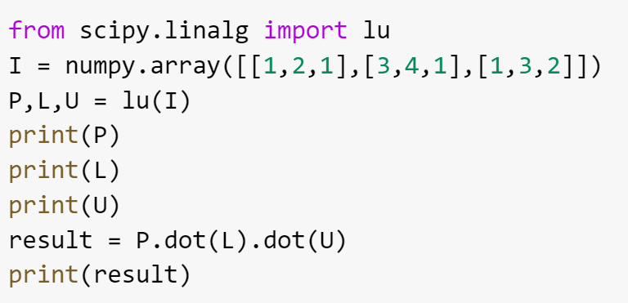
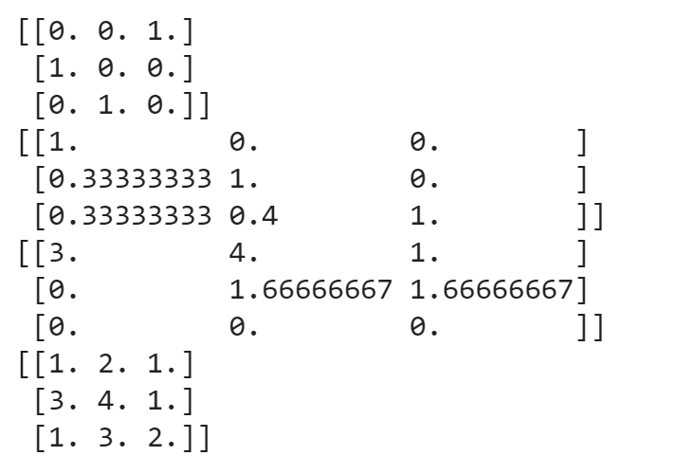
Hands on - Python
Output
In this example, we have used the lu module from scipy.linalg. Where P is for partial pivoting for stable calculations.

Slide 64
QR Decomposition
QR decomposition deals with the matrices that have dimensions in the form of mxn. QR decomposition is the method in which the matrix A is decomposed in the following manner:
A = Q.R
Where Q is a matrix with dimensions mxm and R is an upper triangle matrix with dimensions mxn.
a11 | a21
a21 | a22
a31 | a32
Q11 | Q12 | Q13
Q21 | Q22 | Q23
Q31 | Q32 | Q33
r11 | r12
0 | r22
0 | 0

Slide 65
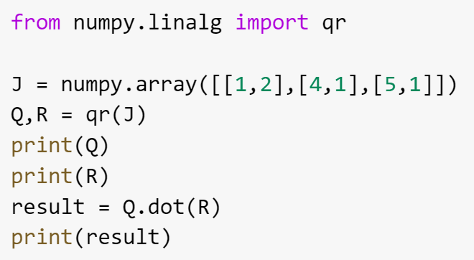
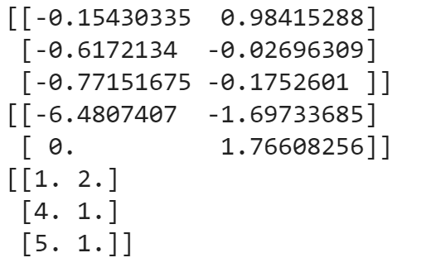
Hands on - Python
Hands on - Python
Output
In this example, we have used the qr module from numpy.linalg. Where there is another parameter mode, which is optional.

Slide 66
Cholesky Decomposition
Cholesky decomposition method deals with the square symmetrical matrices that have positive Eigen values. The matrix A is decomposed in the following manner:
A = L.A^{T}
Where L is the lower triangle matrix and is multiplied with the transpose of the matrix A.
T
a11 | a12 | a13
a21 | a22 | a23
a31 | a32 | a33
L11 | 0 | 0
L21 | L22 | 0
L31 | L32 | L33
a11 | a12 | a13
a21 | a22 | a23
a31 | a32 | a33

Slide 67
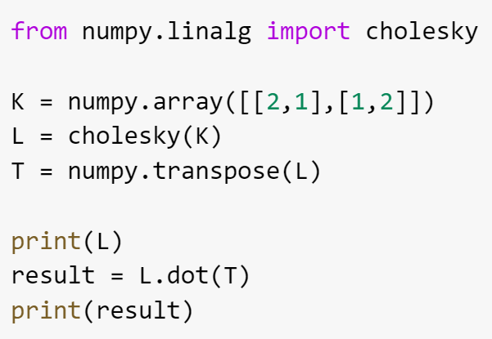
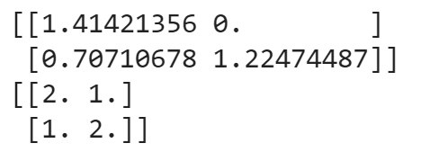
Hands on - Python
Output
In this example, we have used the cholesky module from numpy.linalg. Also, we have to make sure the matrix is positive definite matrix in order to get the efficient results.

Slide 68
Eigen Values And Eigen Vectors

Slide 69

Characteristic Polynomial
A characteristic polynomial is used to derive the Eigen values of a given matrix. The characteristic polynomial of a matrix A is denoted by the function given below.
The characteristic polynomial of the square matrix A is given by the function f(λ), and the I is the identity matrix. The whole objective of using the characteristic polynomial is to find the Eigen values of the given matrix.

Slide 70
Eigen Value
Eigen values are the roots of the characteristic polynomial of the matrix A. Let’s understand this with a simple example.
2 | 1
4 | 3
To calculate the Eigen values of the given matrix, we will first compute the characteristic polynomial and then derive the Eigen values by finding the roots of the Characteristic polynomial.

Slide 71
Eigen Value
To find the characteristic polynomial, we will calculate the determinant of (A - λI_{n} ).
The computation will get the resultant characteristic polynomial as:
f(λ ) = λ² - 6 λ +1
5 | 2
2 | 1
Now, to find the eigen values, we will calculate the roots of the characteristic polynomial.

Slide 72
Eigen Values
f(λ ) = λ² - 6 λ +1
-> λ² - 6 λ +1 = 0
Using the quadratic formula, we can get the roots of the equation as 3 + 2√2 and 3 - 2√2.
5 | 2
2 | 1
Therefore, the Eigen values for the given matrix are 3 + 2√2 and 3 - 2√2

Slide 73
Eigen Vectors
Now to calculate the Eigen vectors, we will do the following:
1. We will use the equation, Av = λv where v is the eigen vector.
5 | 2
2 | 1
5 | 2
2 | 1
X
Y
X
Y
λ .

Slide 74
Eigen Vectors
5 | 2
2 | 1
X
Y
X
Y
λ .
Using the equations that we get by solving the above equation for both the values of λ, we will get the Eigen Vectors of the given matrix.

Slide 75
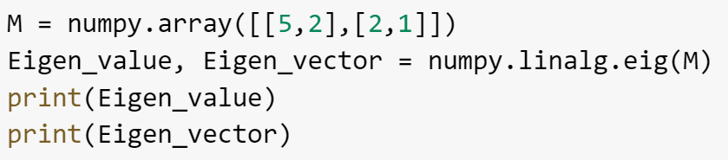
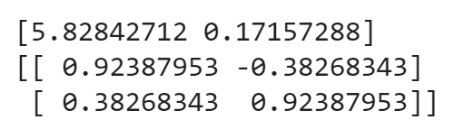
Hands on - Python
Output
In this example, we have used the numpy.linalg.eig() method to calculate the eigen values and eigen vectors of the given matrix M.

Slide 76
Correlation Matrix
Collinearity is a concept in statistics that resonates with the linear relationship between the predictor variables(independent variable) in a regression model. If the independent variables are correlated, they won’t be able to independently predict the value of the dependent variable in the regression model.
A correlation matrix is a table that has the correlated coefficients between the variables. It is mostly used to deduce the patterns in a large dataset.

Slide 77
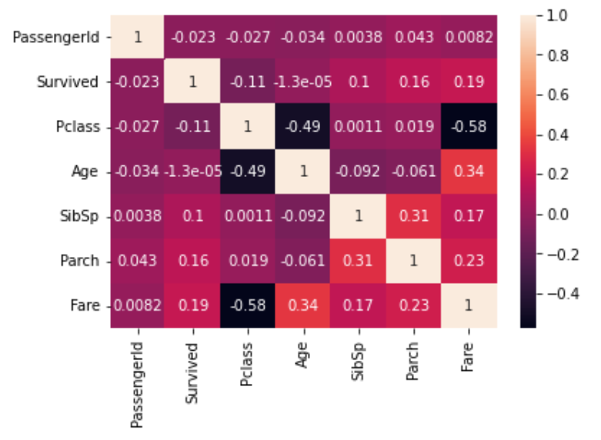
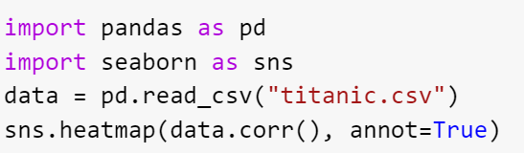
Hands on - Python
In this example, we have plotted the correlation coefficients of the titanic data on a heatmap using seaborn in python. By the value of the correlation coefficient, we can figure out the collinearity of the predictor variables.

Slide 79

India: +91-7847955955
US: 1-800-216-8930 (TOLL FREE)
support@intellipaat.com
24/7 Chat with Our Course Advisor
Notes:
Thank you!

